Slide 1
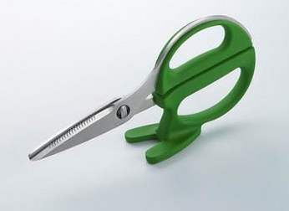
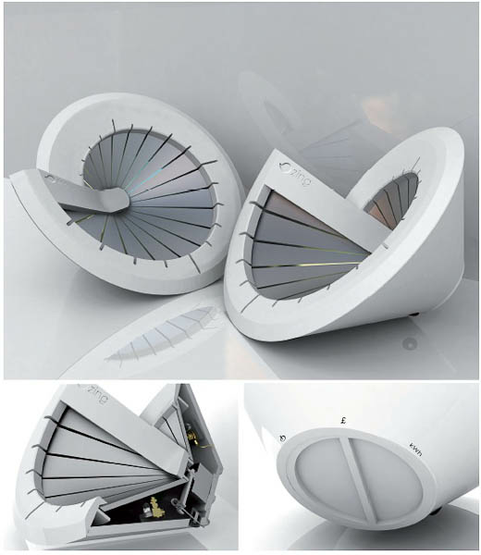
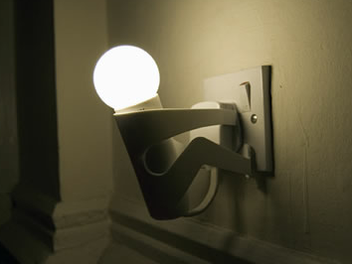

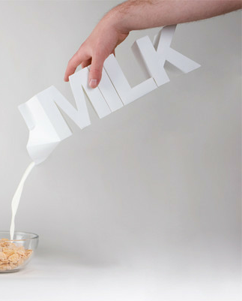
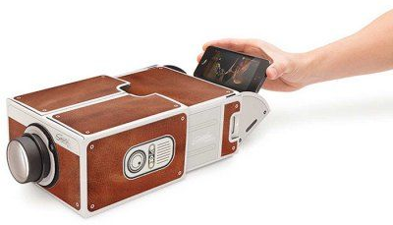
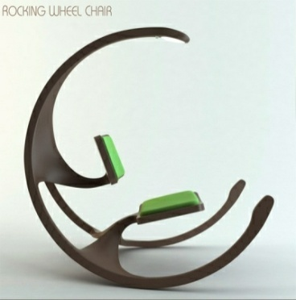
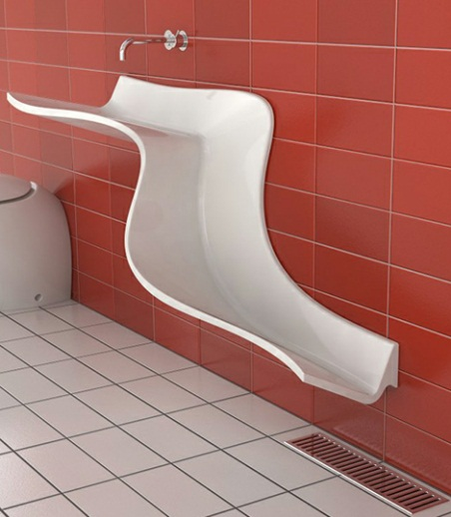
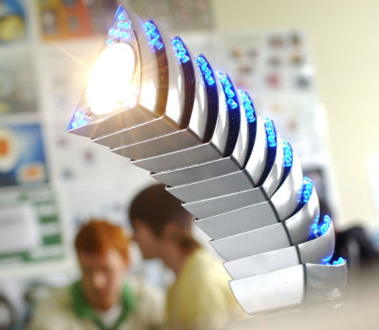
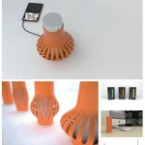
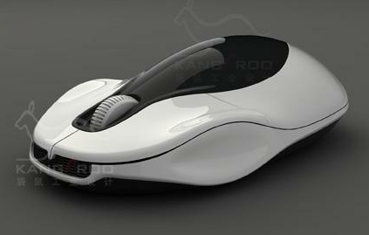
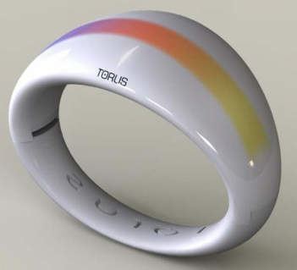
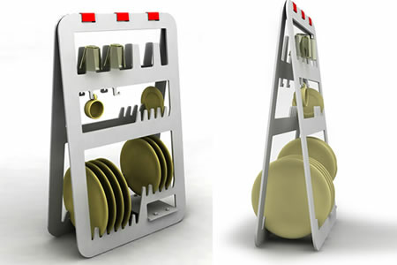
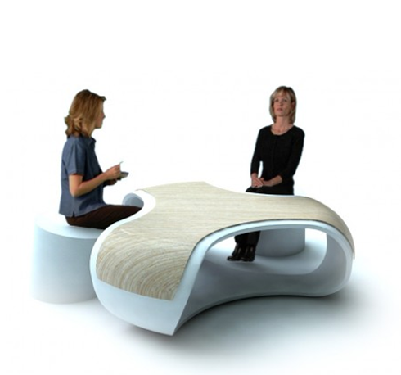
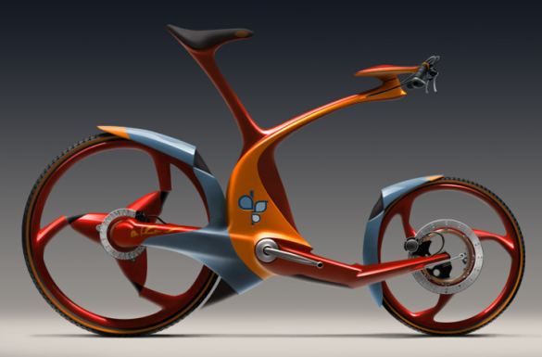
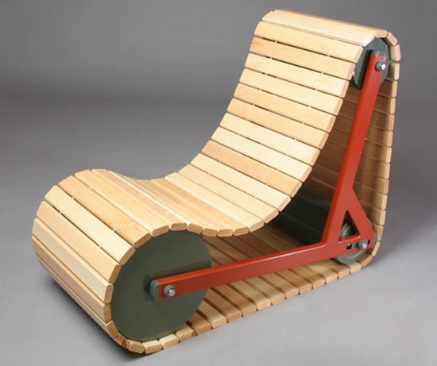
DESIGN
iGCSE Design Technology Introduction
Notes:
Demonstration of pewter casting
- Features of moulds & potential issues
- Demonstration of hand made mould to
pewter casting
- Student create practice mould using hand
tools and cast.

Slide 2
Table Re-Design: Lesson 1
Learning Objectives
Learn to think creatively
Learn to set criteria / specification for a design
Communicate Design ideas
Present a design concept
DESIGN

Slide 3
Table Re-Design
Cover Lesson 2 Tasks
Complete all unfinished tasks from last lesson (MAX 20 minutes)
Take out your table drawing from lesson 1
Think Pair Share: What are these?
Overview: Table Re-Design Task:
Set criteria for your table re-design
Produce a series of sketches to show your design ideas for the table re-design.
Extension: Present your Re-Design in a one page design sheet with initial sketches, design criteria and final product visualisation (Gemini)
DESIGN

Slide 4
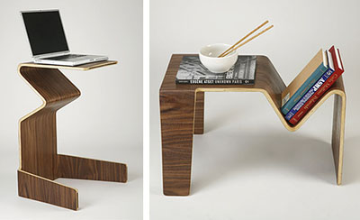
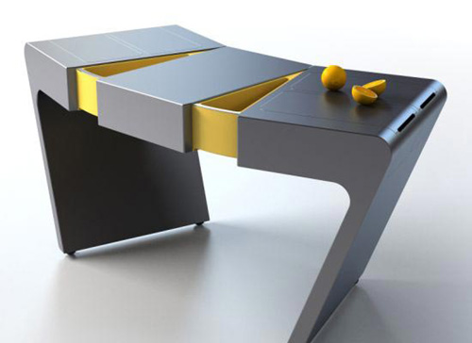
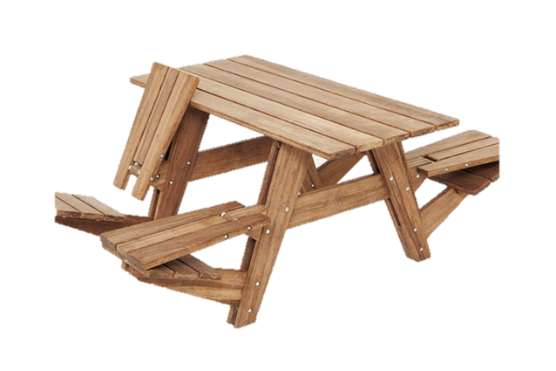
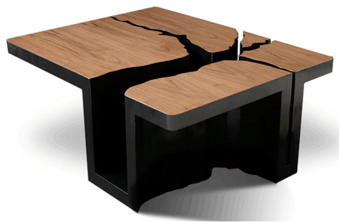
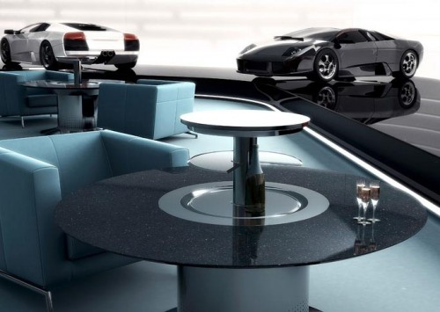
IGCSE Design Technology
Rethink - 3D Table?
DESIGN

Slide 5
IGCSE Design Technology
Table Redesign
Now look at your first table drawing.
Is it creative? Do tables have to have a set number of legs or be a set shape?
Task.
Now re-design your table trying to be more creative. First you need to think of a user, theme, or environment (place) it will go in.
DESIGN

Slide 6
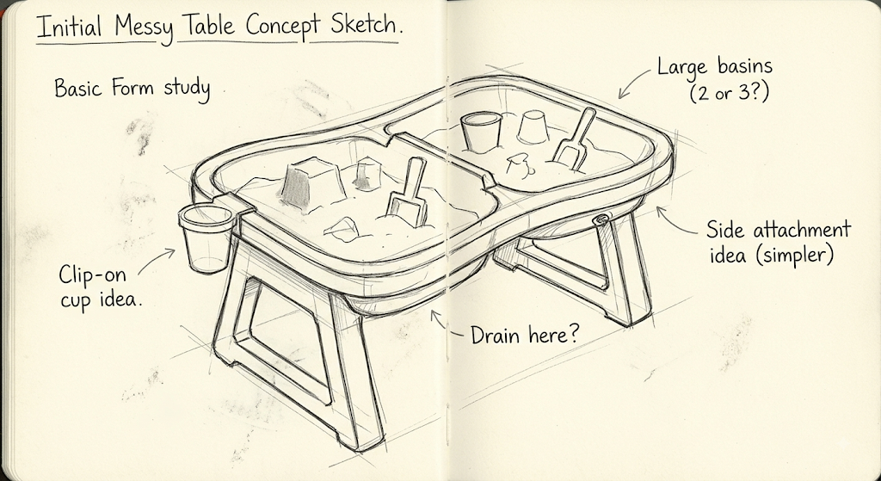
IGCSE Design Technology
EXAMPLE
Table Redesign
Task.
Re-design your table by first defining the following criteria:
User / Target Audience
Main Function
Environment where it is used
Approximate Size
Aesthetics (must be desirable to your user!)
Material suggestions
DESIGN
3-6 year olds kindergarten children
Height max 5o cm and 60x80 cm footprint
Plastic (water proof and light-weight)
Colourful and cheerful, primary colours, rounded corners for added safety
Can be used indoor and outdoors
Messy-play, sand play

Slide 7
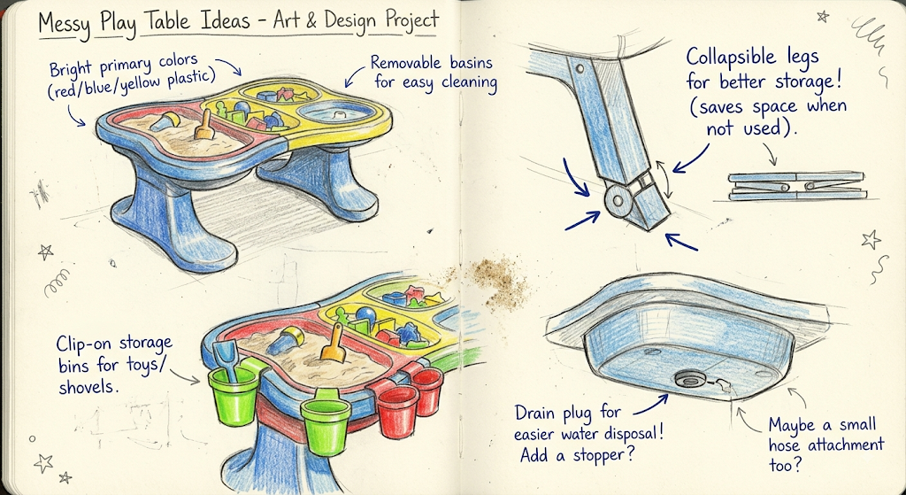
IGCSE Design Technology
Table Redesign - Idea Development
Task.
Develop your table idea by creating a series of sketches to show details
Render your sketches
Annotate
Present your sketches
Example
DESIGN

Slide 8
Table Re-Design: Lesson 2-3
Learning Objectives
accurately model to scale
quickly develop the form / aesthetics of a product idea
use modeling as a form for development of ideas in form and function
Learning methods to present your work appropriately
DESIGN

Slide 9
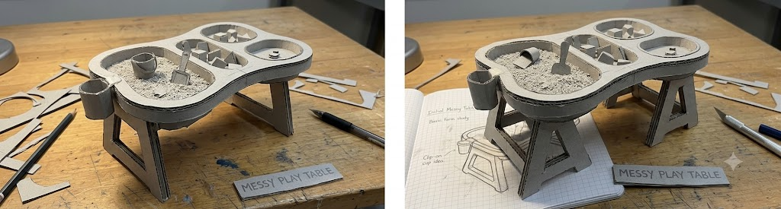
IGCSE Design Technology
Table Redesign - Idea Development through modeling
Task.
Develop your idea by creating a series of card models 1:10
Change features from design to design
Photograph each model
Present your models
Example
DESIGN

Slide 10
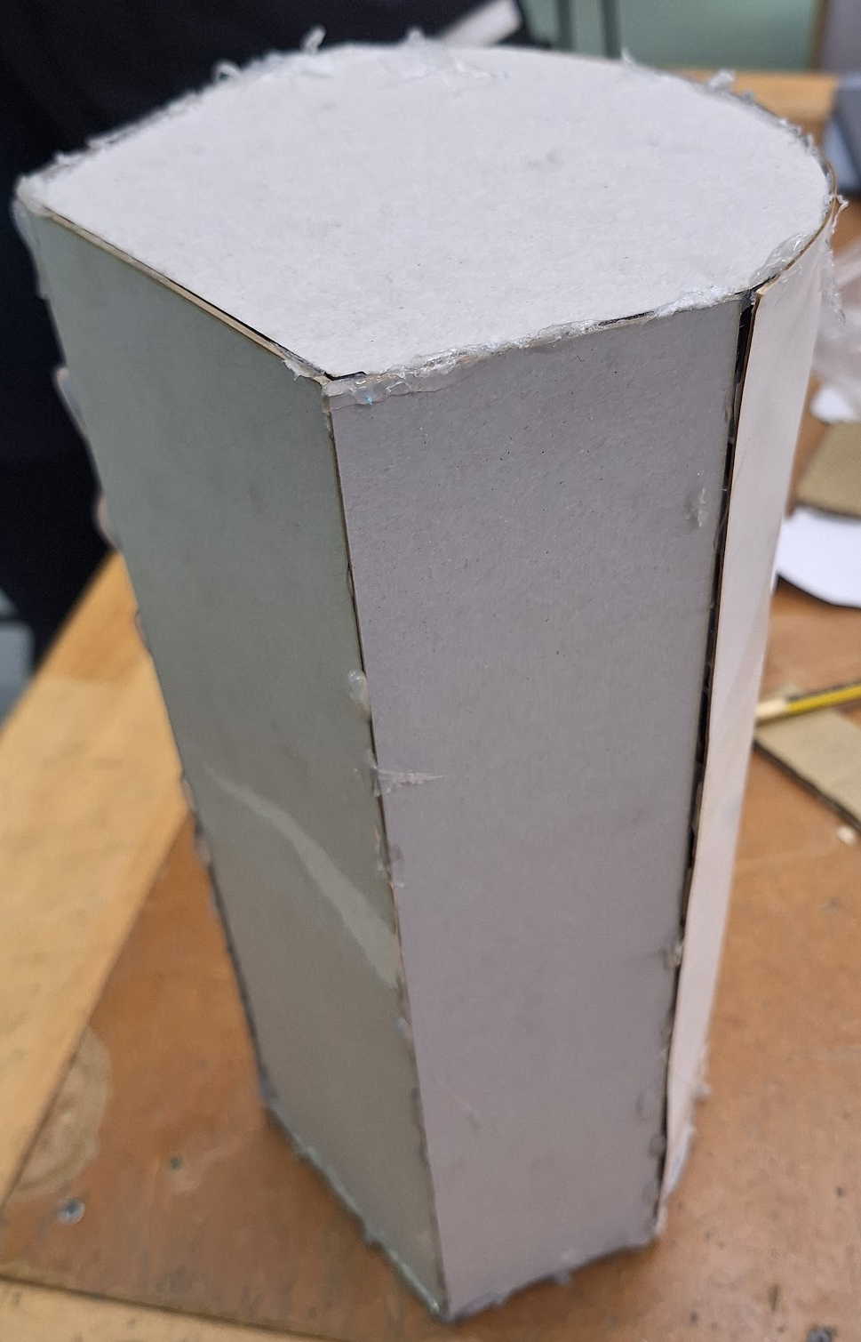
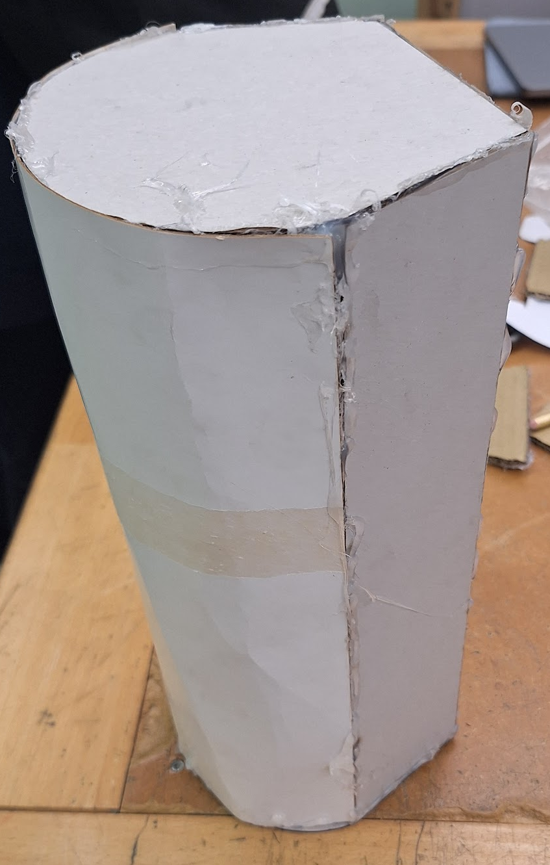
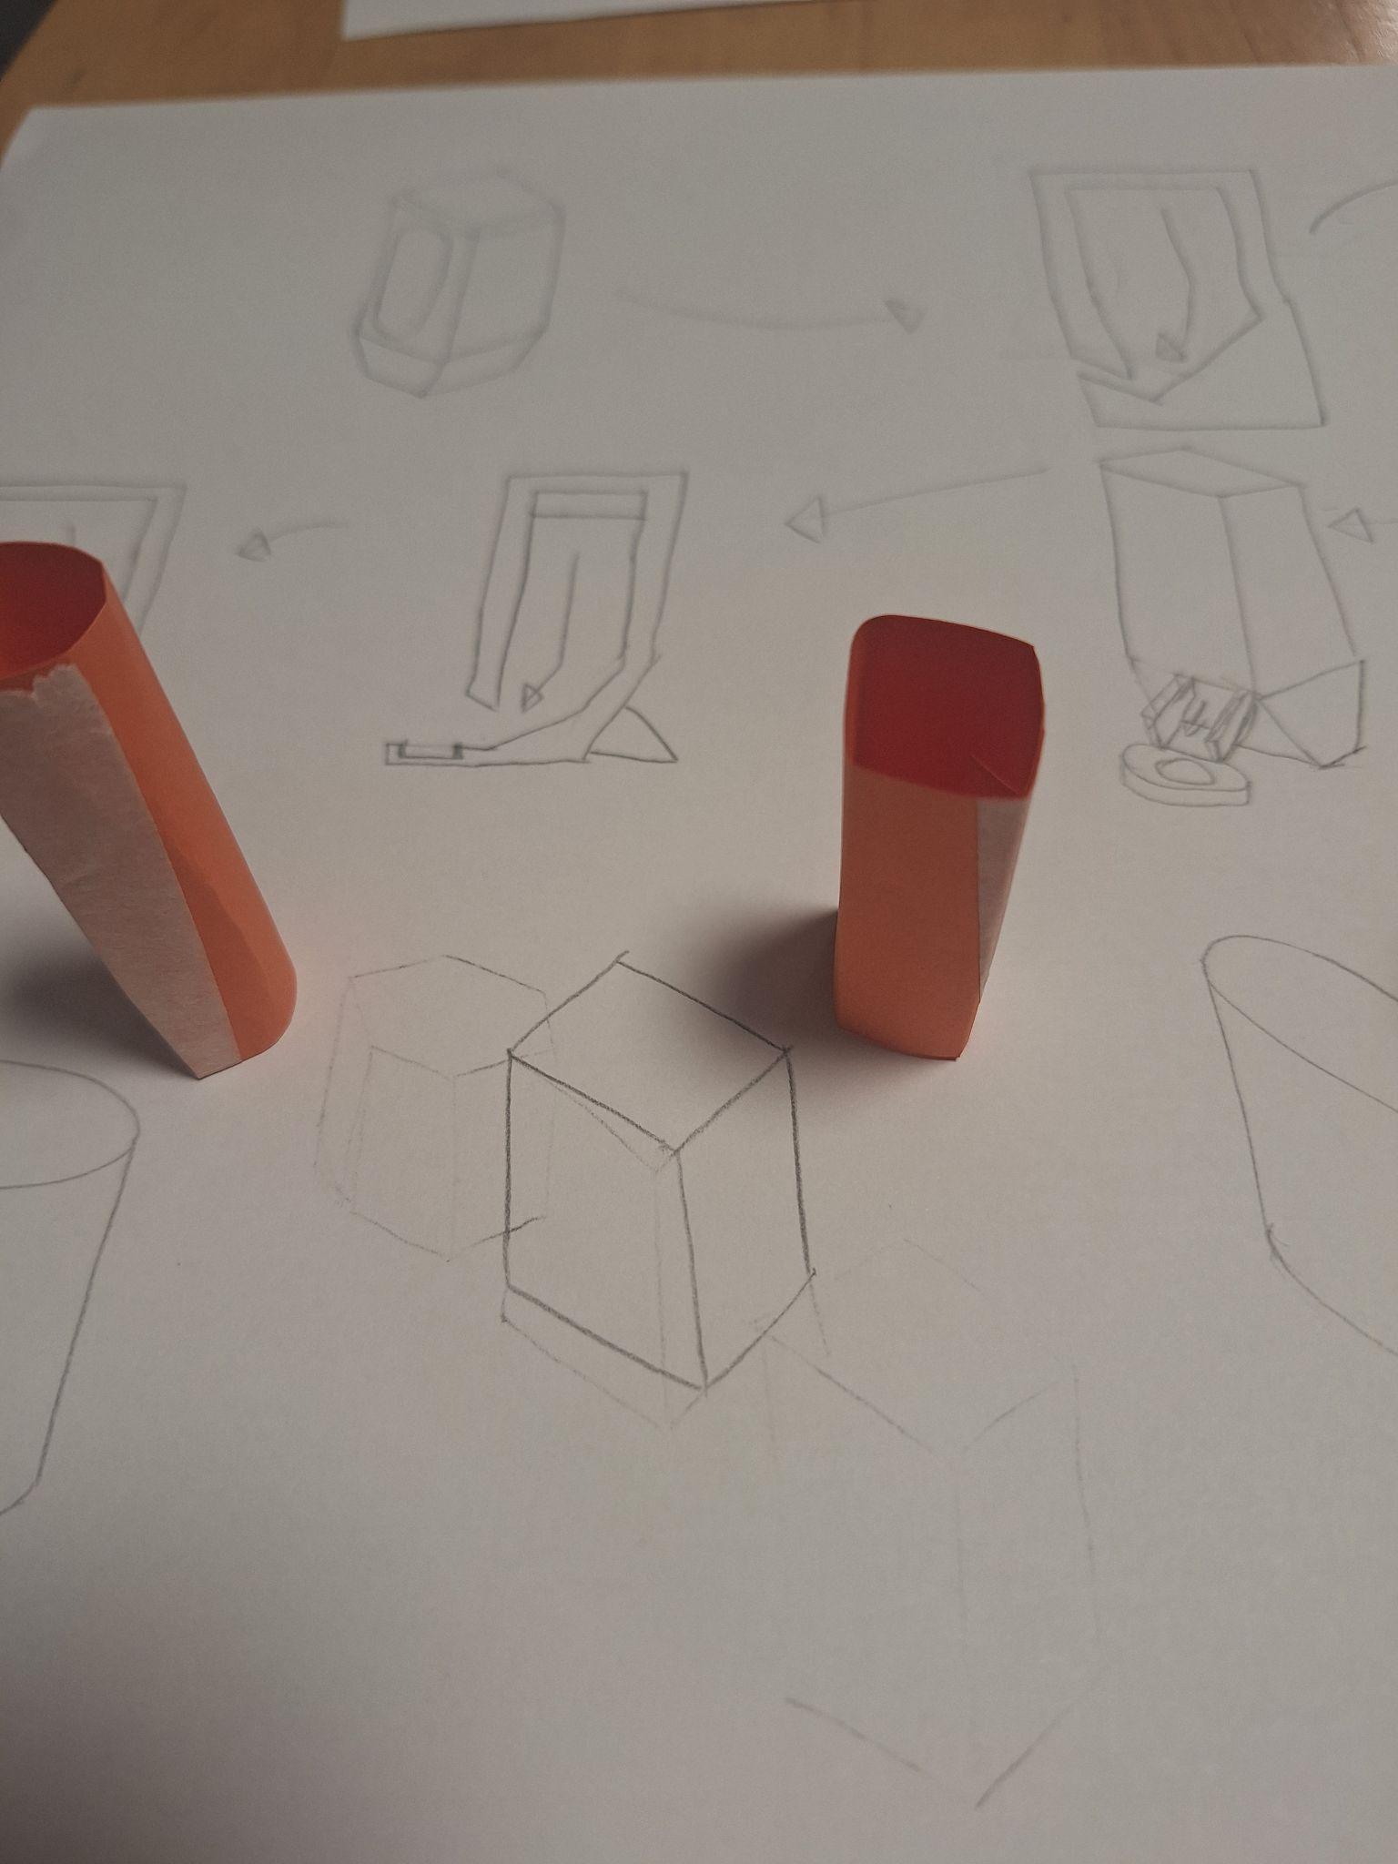
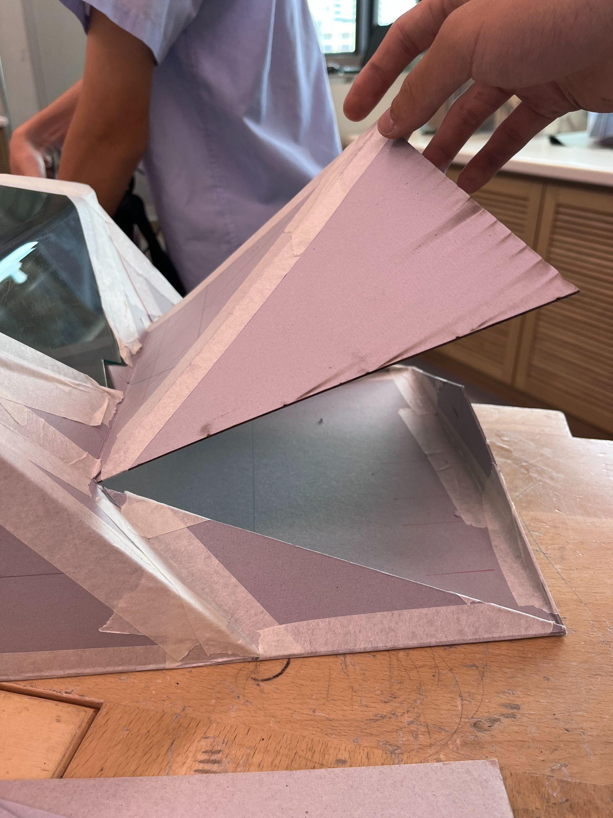
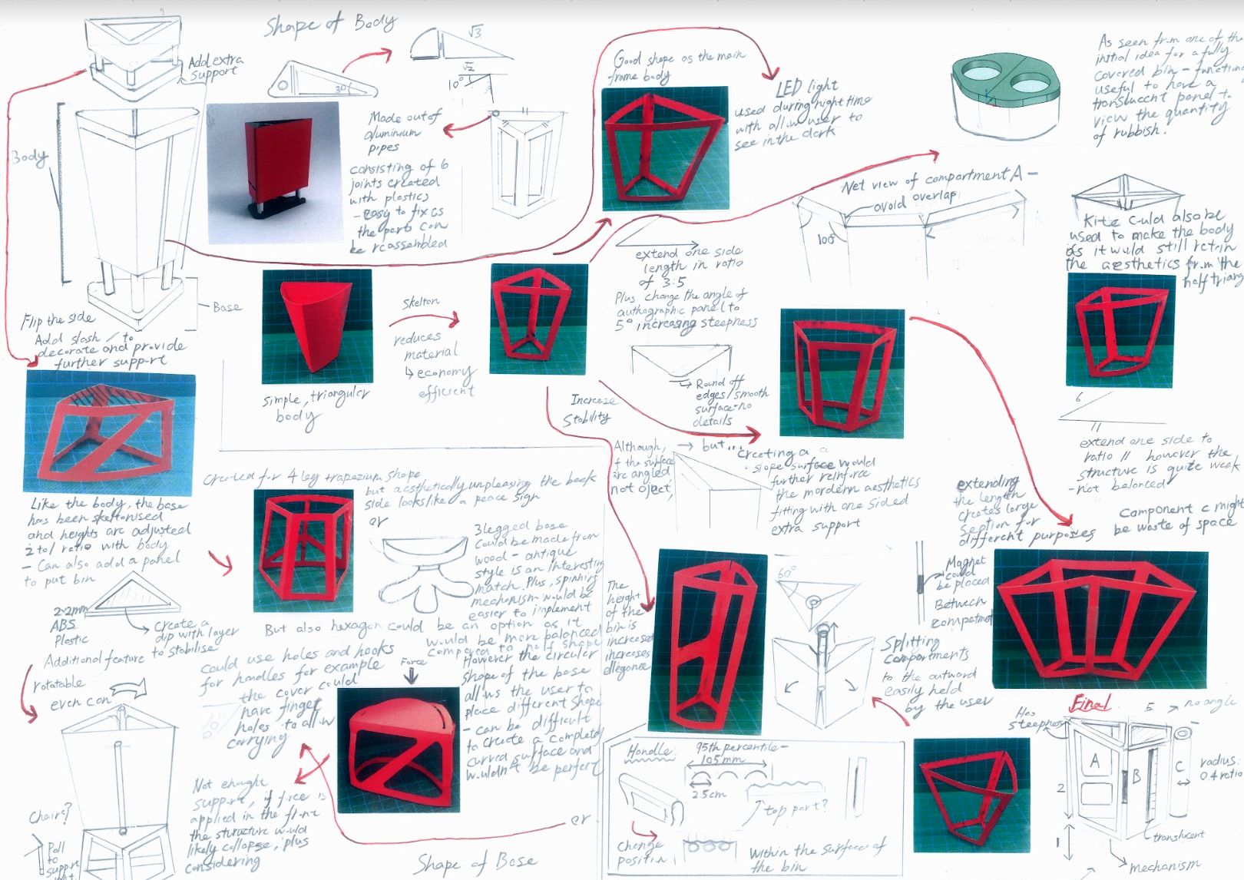
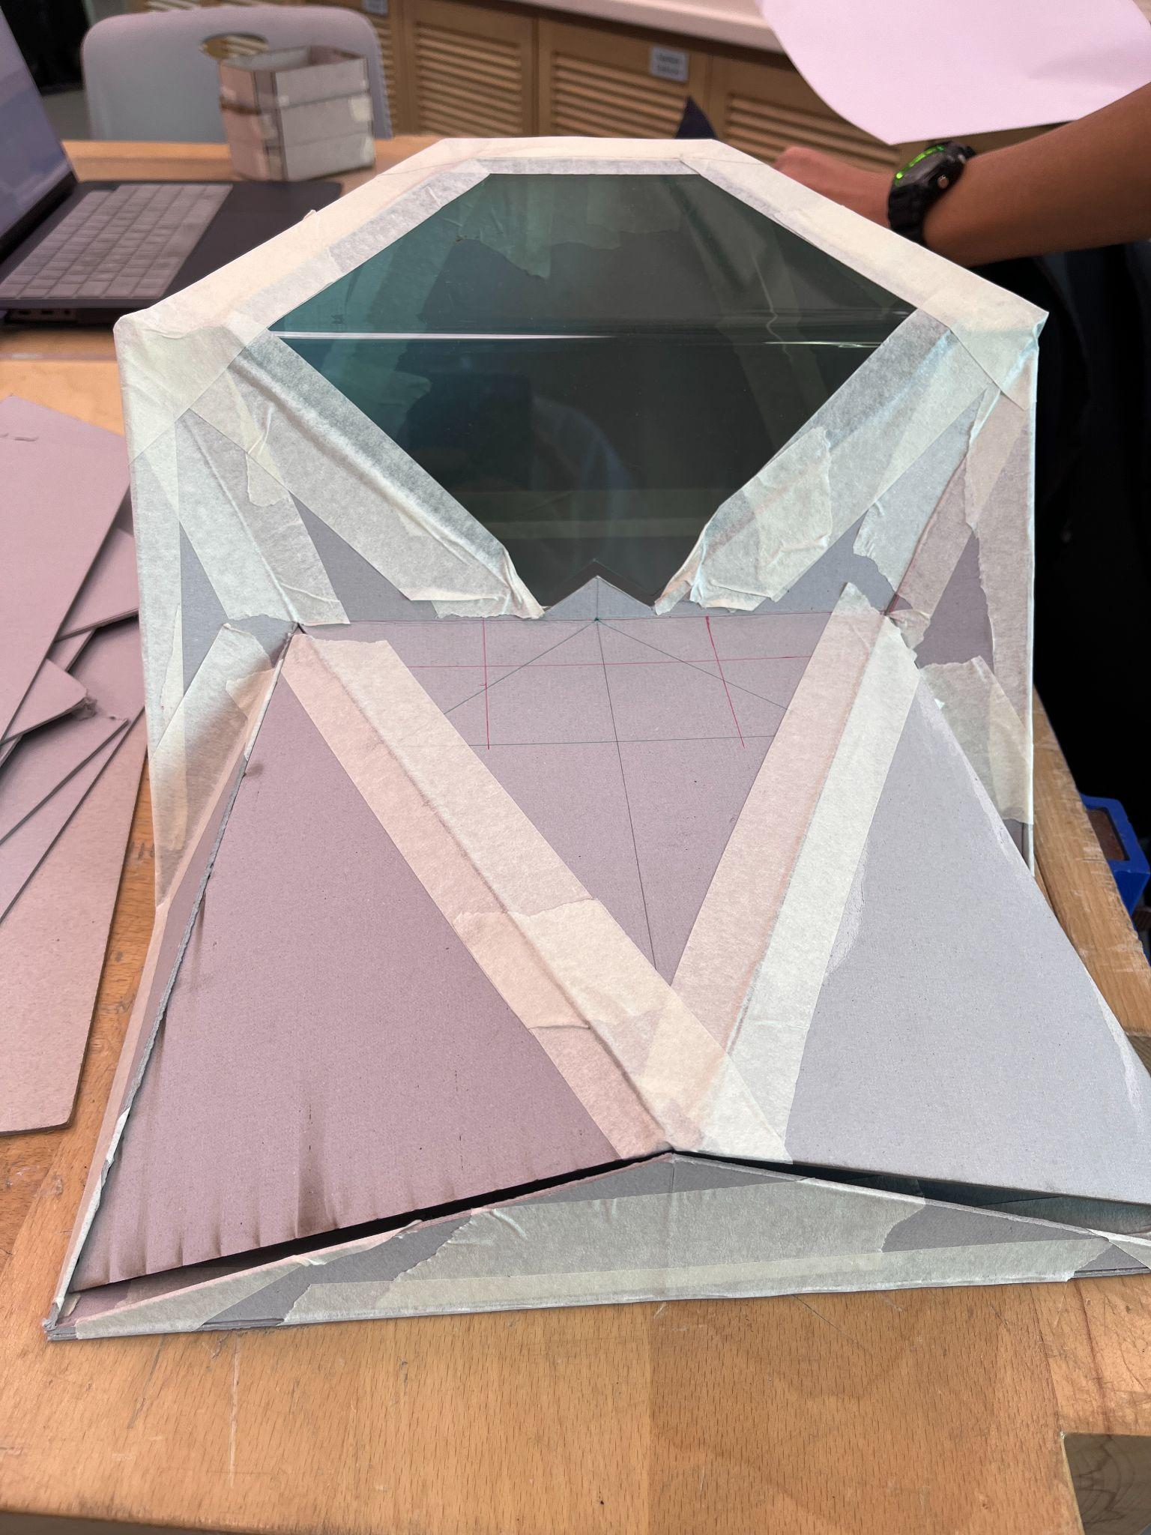
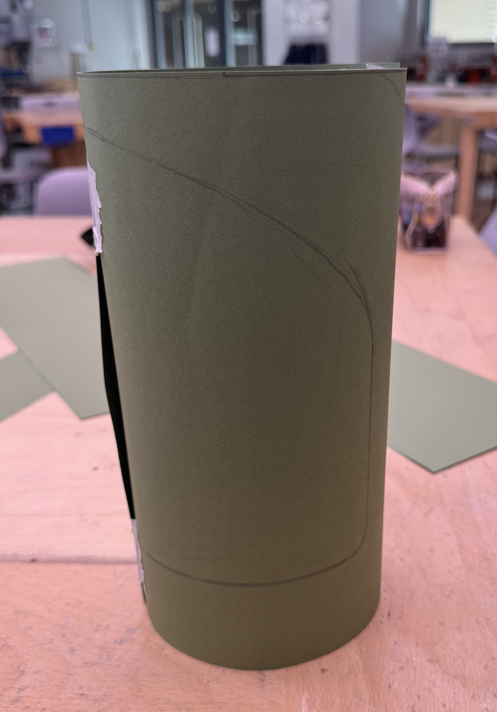
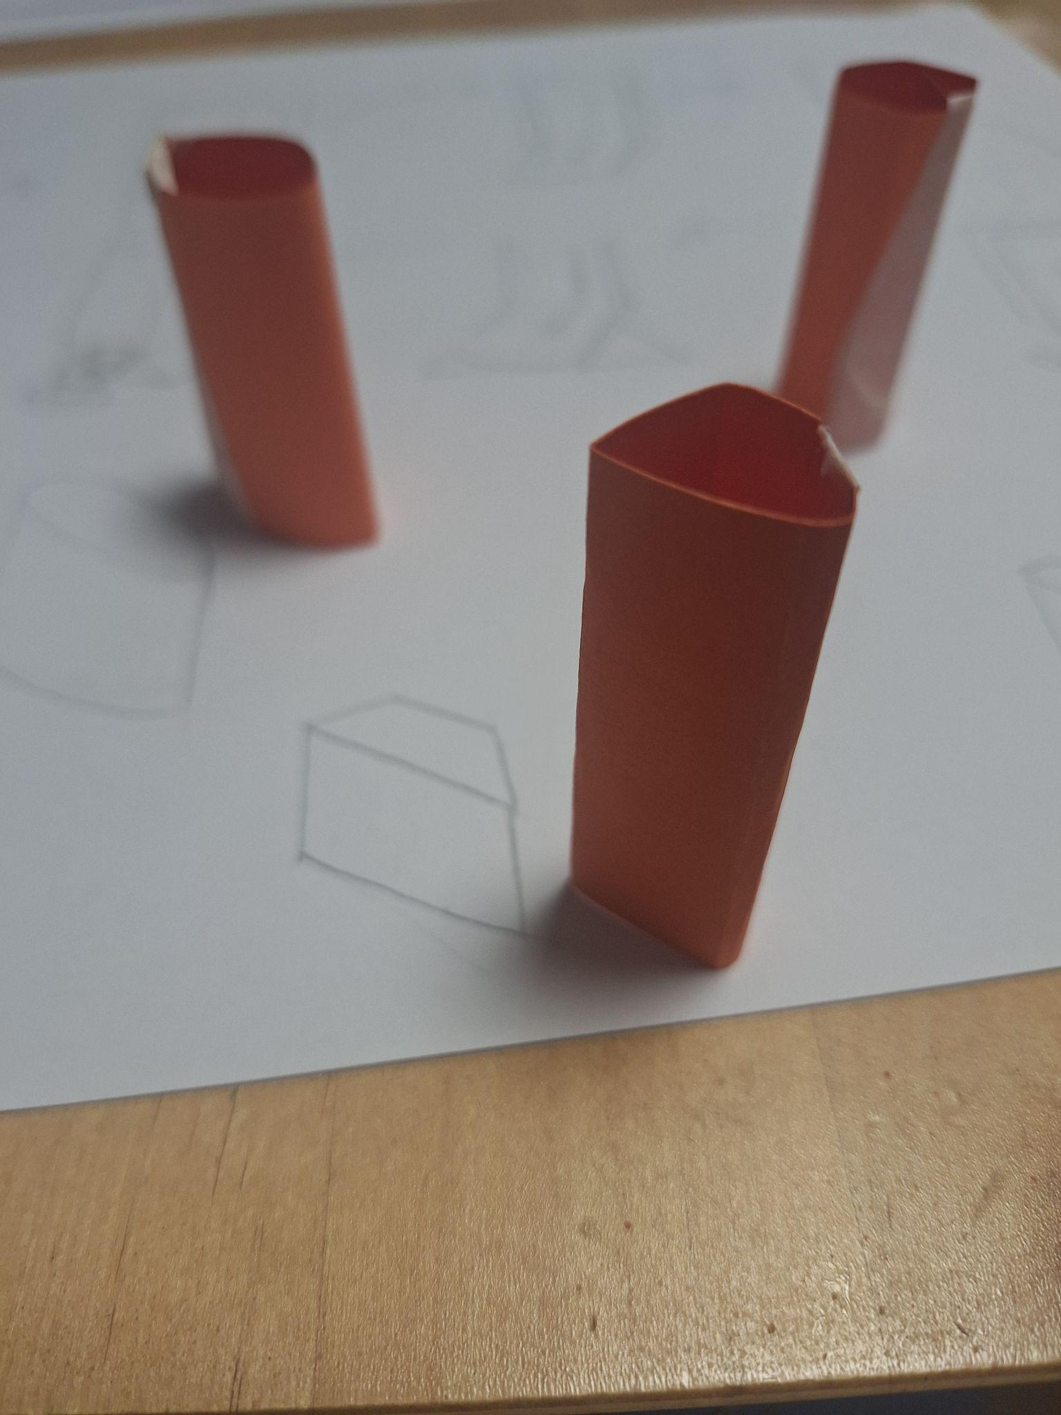
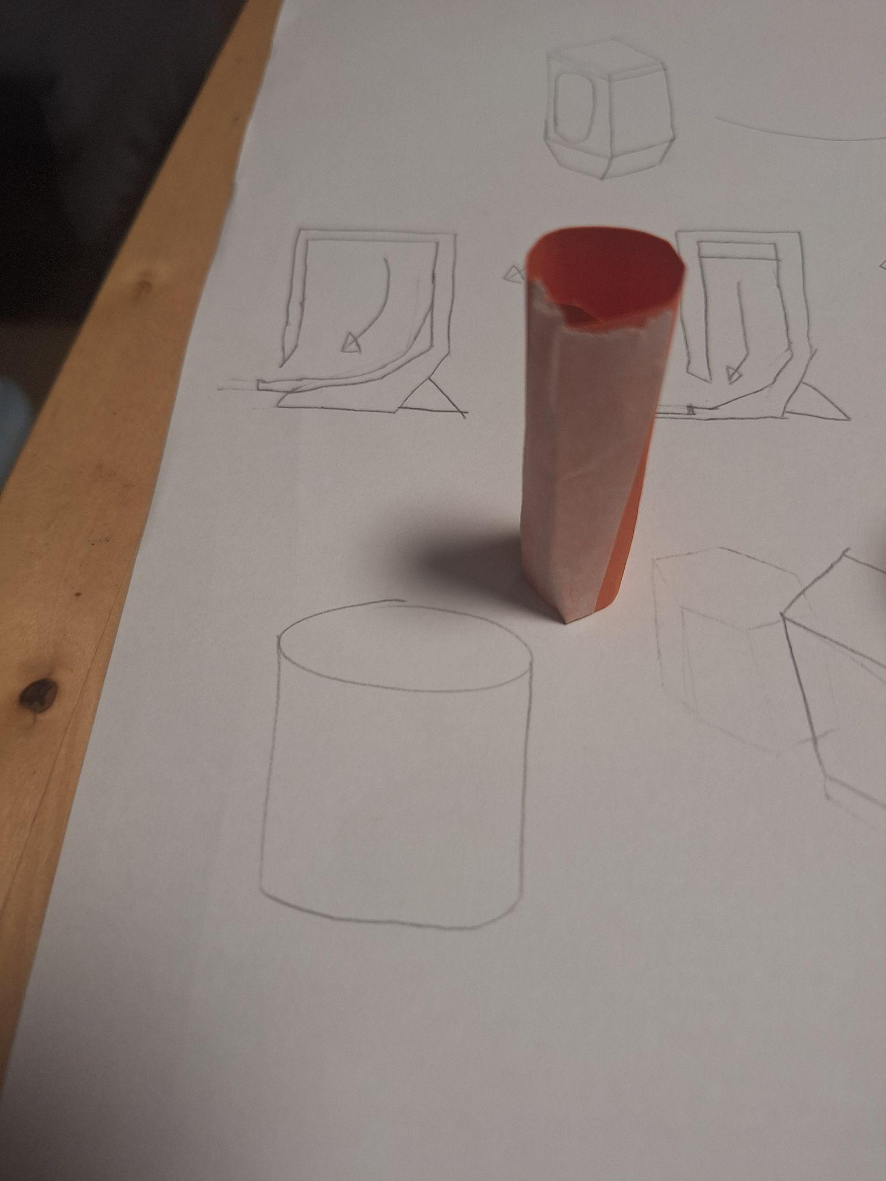
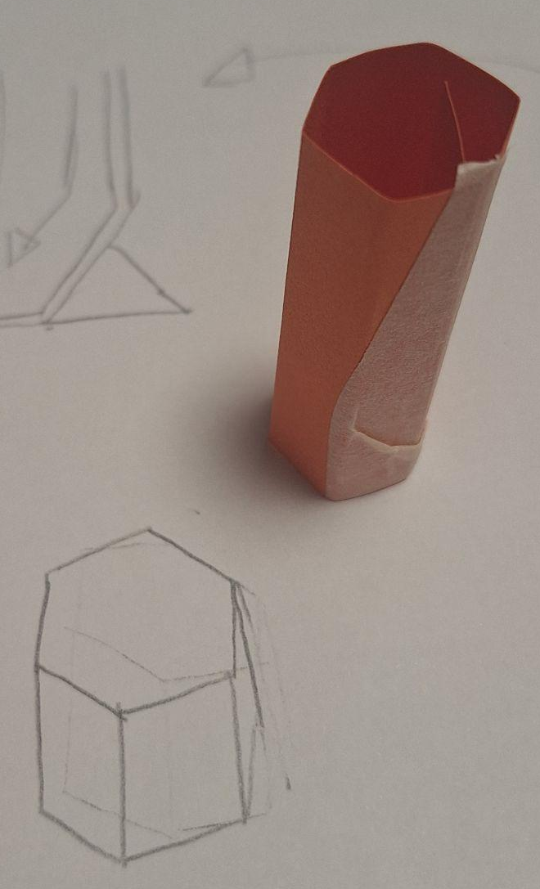
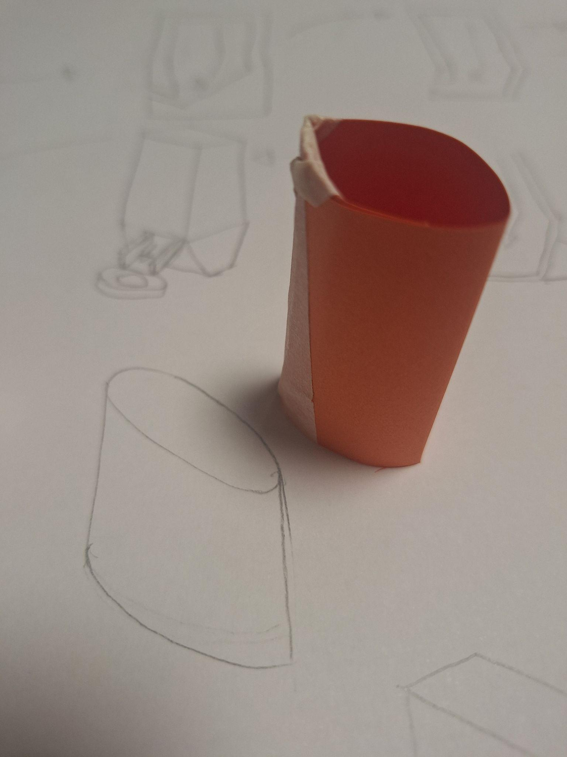
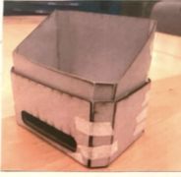
GCSE Introduction Modelling
Modelling examples from past projects
Start basic and build up to more complex models.
It’s good to learn different modelling techniques.
DESIGN
Basic Card models
Grey board models
Blue Foam Components

Slide 11
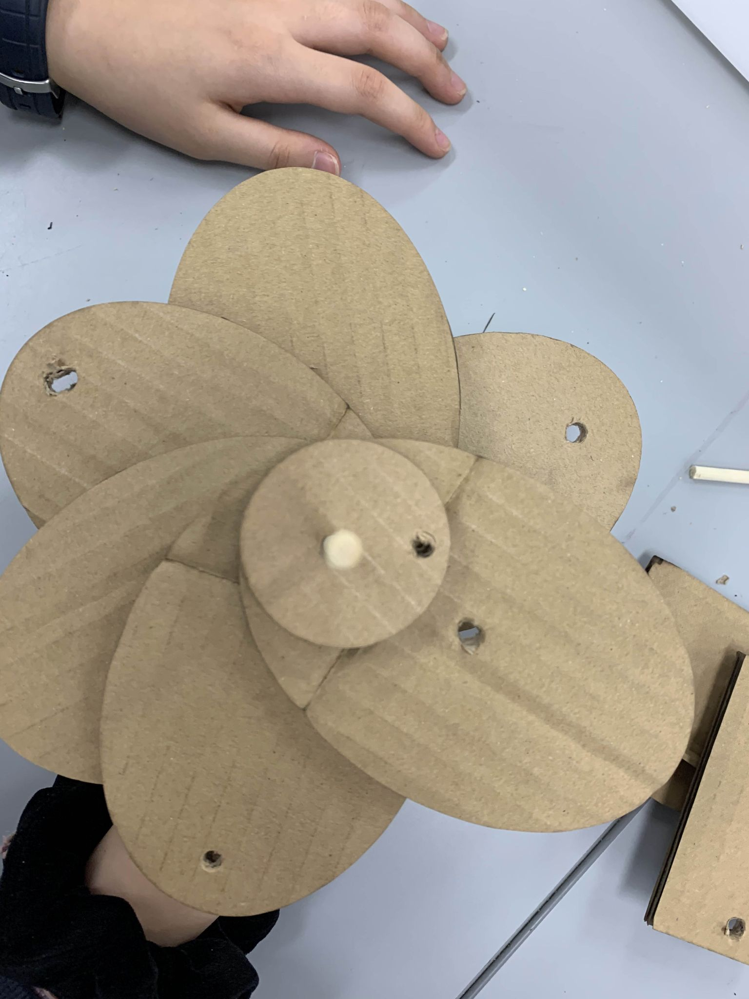
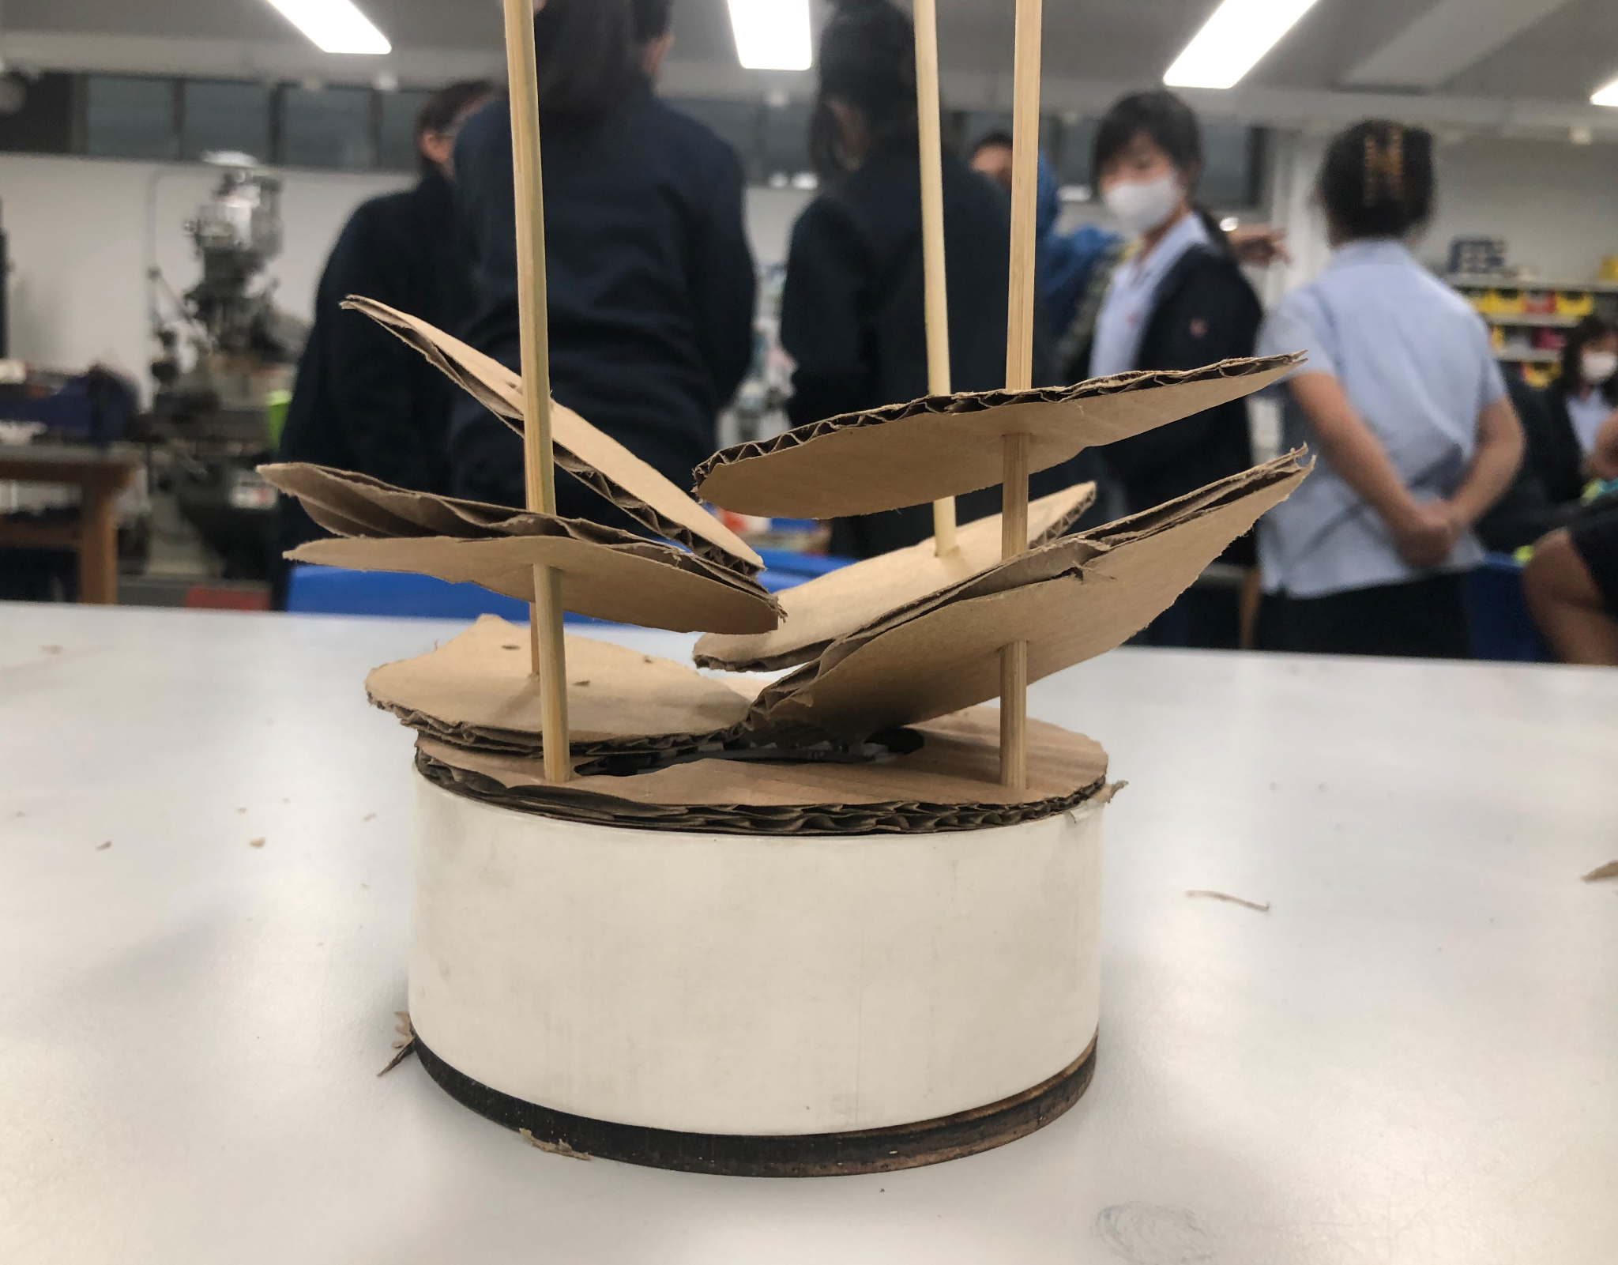
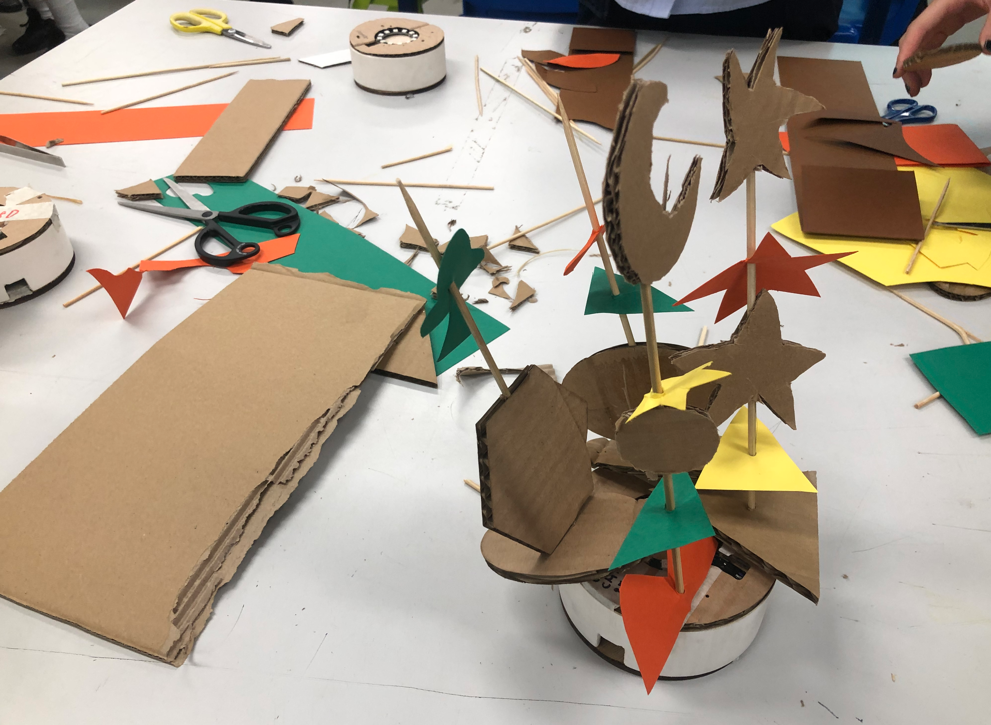
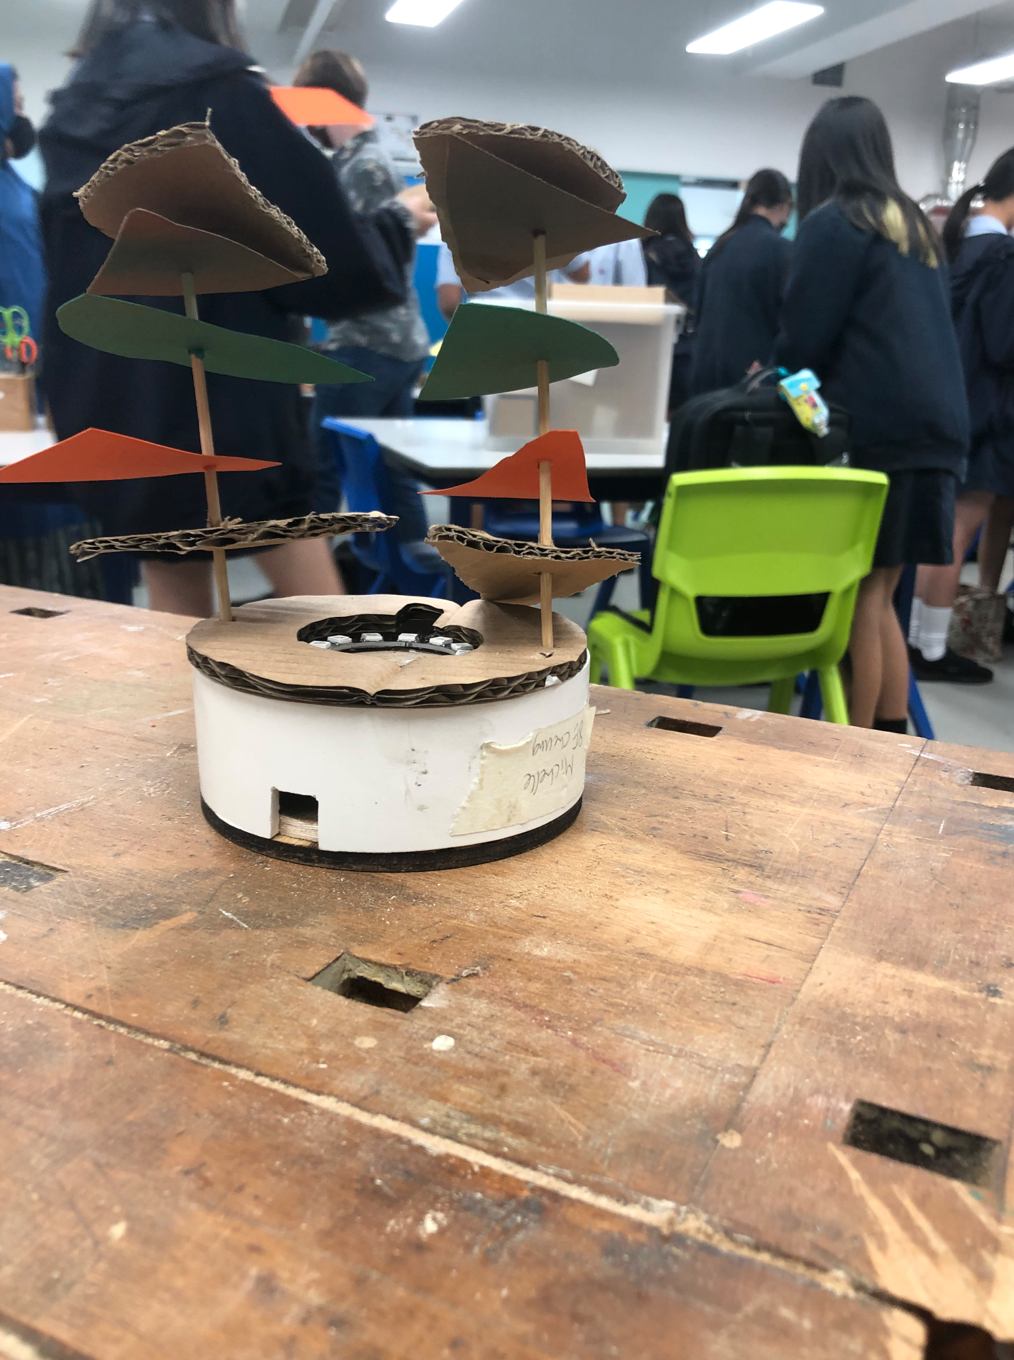
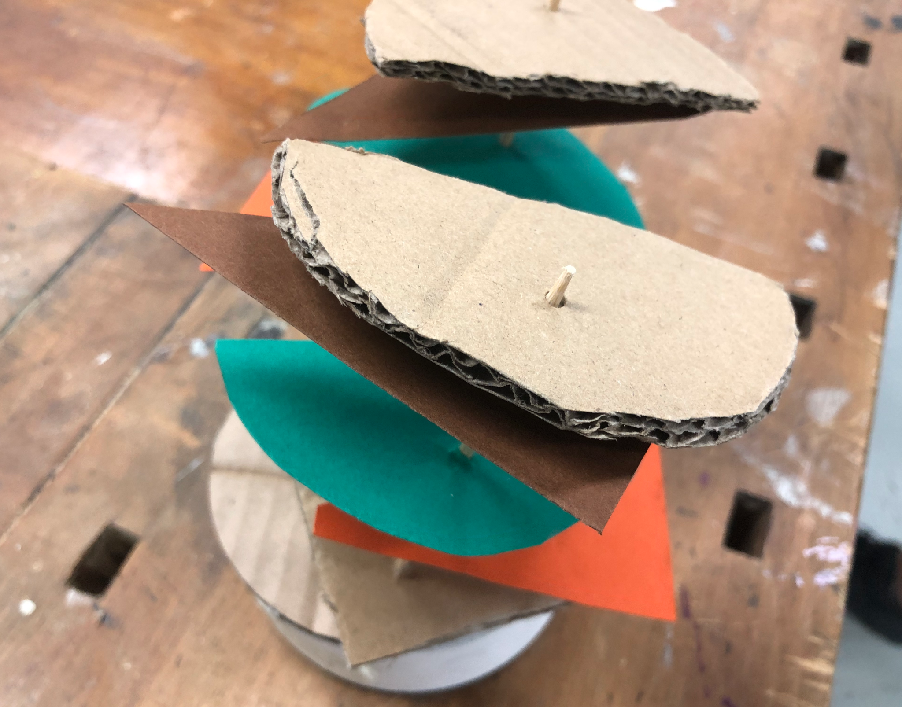
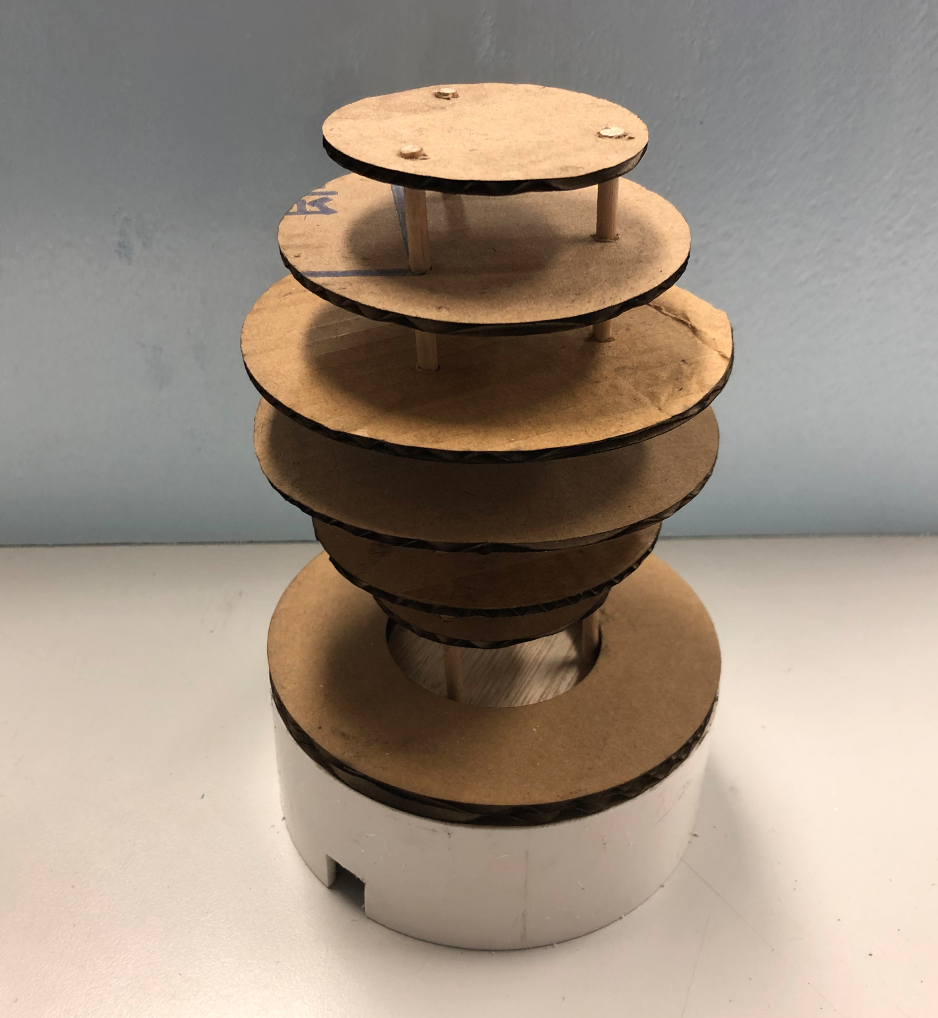
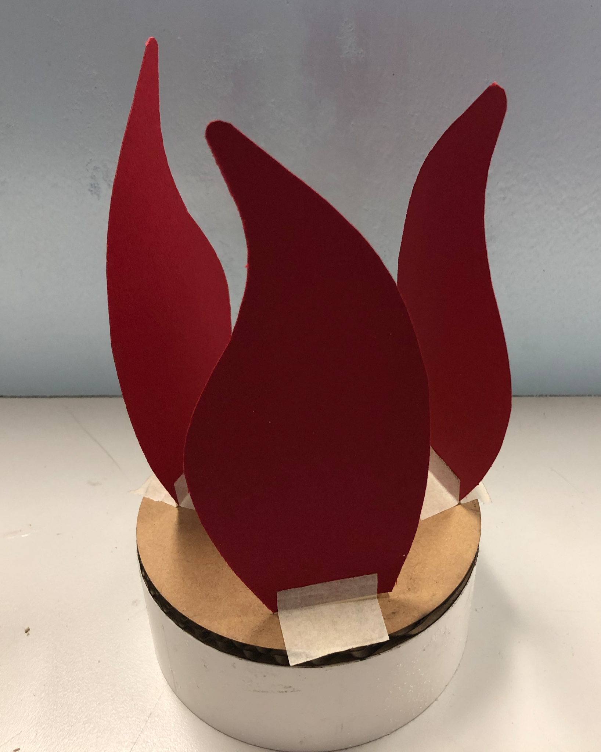
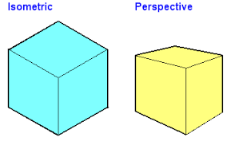
GCSE Design Communication
Presentation - Taking a good photo
DESIGN
Consider:
- The background content
- Contrasting background
- Cropping out the background
- Does it communicate the design
- Do you need multiple photos
- The angle you take the photo at -

Slide 12
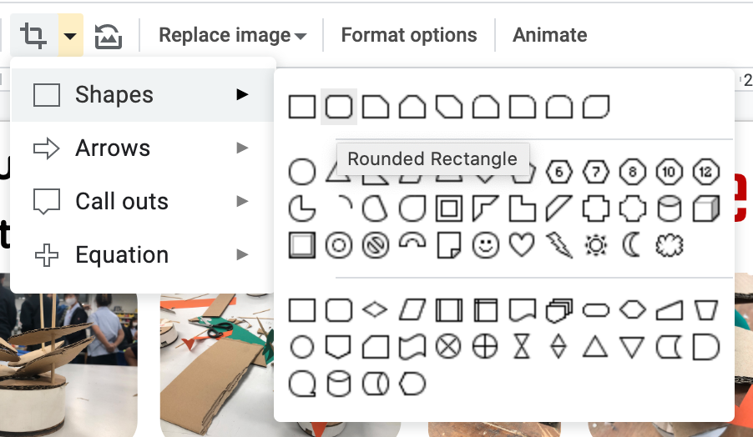
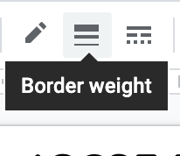
GCSE Design Communication
Presentation - Editing the photo
DESIGN
Crop the photo with a shape
Adjust border weight,
style, border colours

Slide 13

GCSE Design Communication
Presentation - Page layout
Consider:
- How the reader follows the process around the page - use arrows
- Keeping images small - its an A3 page
- Fill the page, don't leave empty spaces.
- Zoning off different areas
- Sketches with models
- Leave room for annotations
DESIGN

Slide 14
GCSE Design Communication
Presentation - Annotations
Consider:
- Write in full sentences
- Write in text boxes around the image/drawing
DESIGN
Changes
What have you done to change your product?
Opinions
What do you think of this latest iteration?
Description
What is the features of this design - ACCESS FM
Improvements
What improvements can you still make for the next iteration?

Slide 15

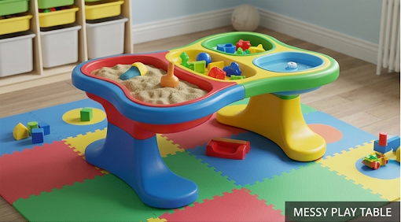

Table - Design
Critical Thinking Skills
Think-Pair-Share
How could you present this to a higher standard?
DESIGN
Is this cheating?
Keywords
Photo-realistic
Colourful
Plastic
Child room
play mat
Child size
Primary colours
What prompt would you use?

Slide 16


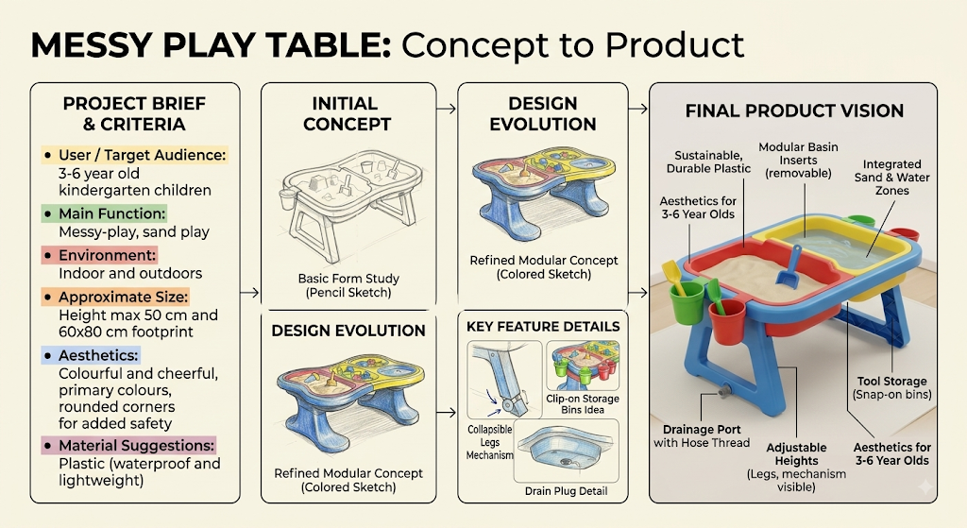
Helping Hand - Design
Creativity Skills
Extension
Communication Skills
Present your Design Process
DESIGN
Keywords
Clean layout
Annotations
Visual Flow
Cropped images
Clean image scans

